Slide 1


Evolution of Mutation
from tree twiddling to LLM agents
Marco Virgolin (Unlayer AI) – 22 June 2026 – SymReg WS 2026

Slide 2
Agenda
The stage: symbolic regression & iterative algorithms
The player: what is meant by “mutation” here
The match: the “evolution” of mutation over 30+ years
  Structural: bit flips, subtree swaps, probabilistic models, linkage models
  Semantic: geometric semantic, semantic backpropagation
  Neural: deep reinforcement learning, pre-trained transformers, hybrids
  LLM/Agentic: optimization by prompting, AlphaEvolve, automodel
An application of LLM/Agentic on friction modeling (paper)

Slide 3
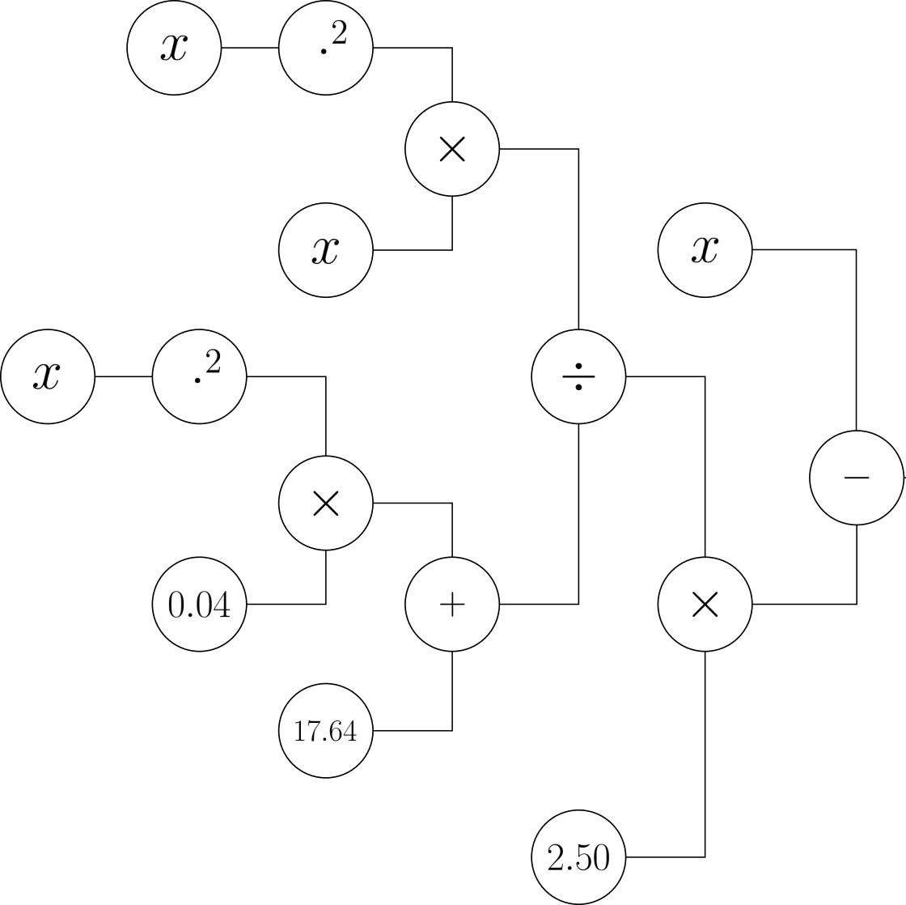
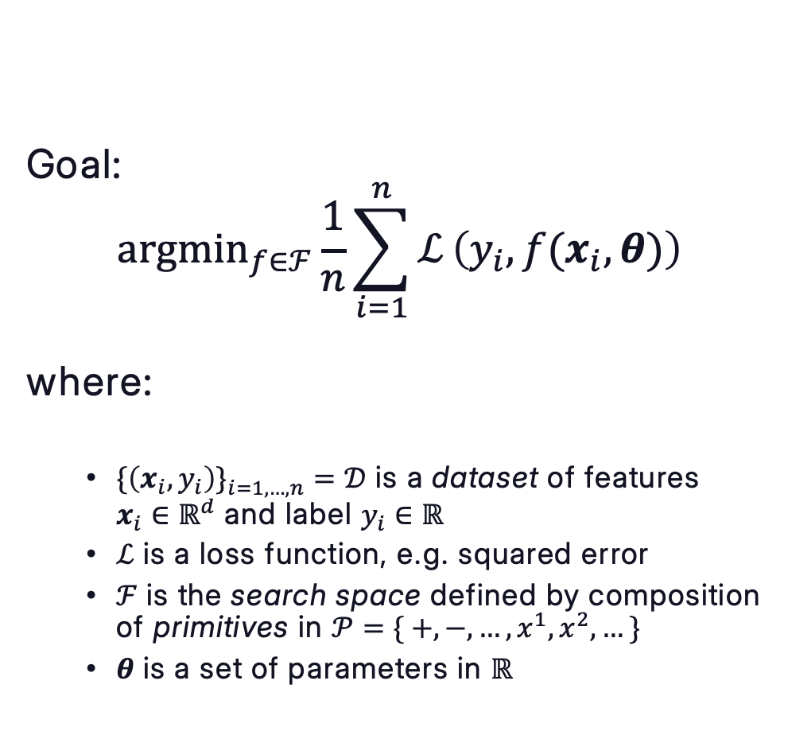
The stage – symbolic regression
Goal:
$${argmin}_{f∈ℱ}\frac{1}{n}\sum_{i=1}^{n}{ℒ}\left(y_{i}, f(x_{i},θ)\right)$$
where:
  $\{\left(x_{i}, y_{i}\right)\}_{i=1,…,n}^{}=𝒟$ is a dataset of features
  $x_{i}∈ℝ^{d}$ and label $y_{i}∈ℝ$
  $ℒ$ is a loss function, e.g. squared error
  $ℱ$ is the search space defined by composition of primitives in $𝒫=\{ +, −, …, x^{1}, x^{2},…\}$
  $θ$ is a set of parameters in $ℝ$
Pic. from [1] – Permission by author

Slide 4
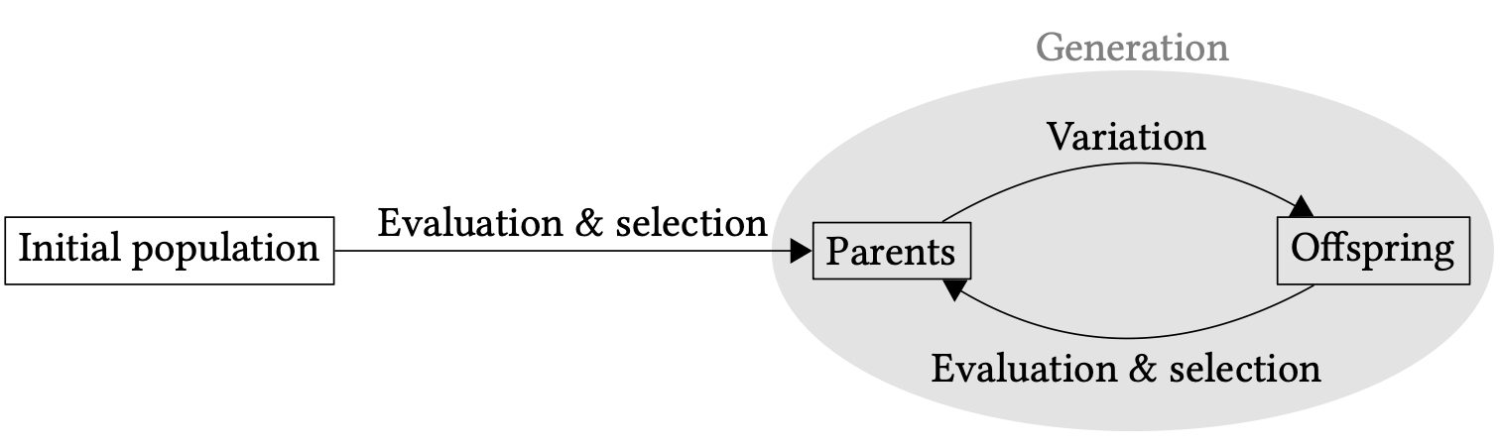
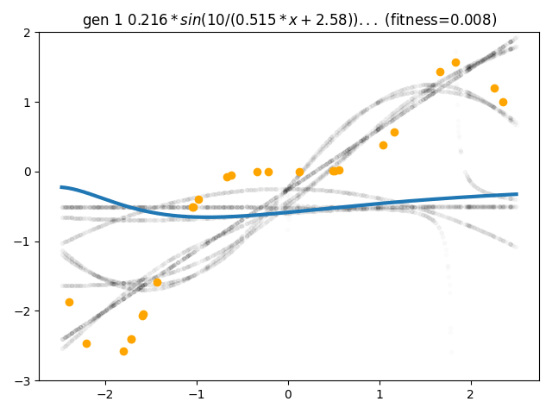
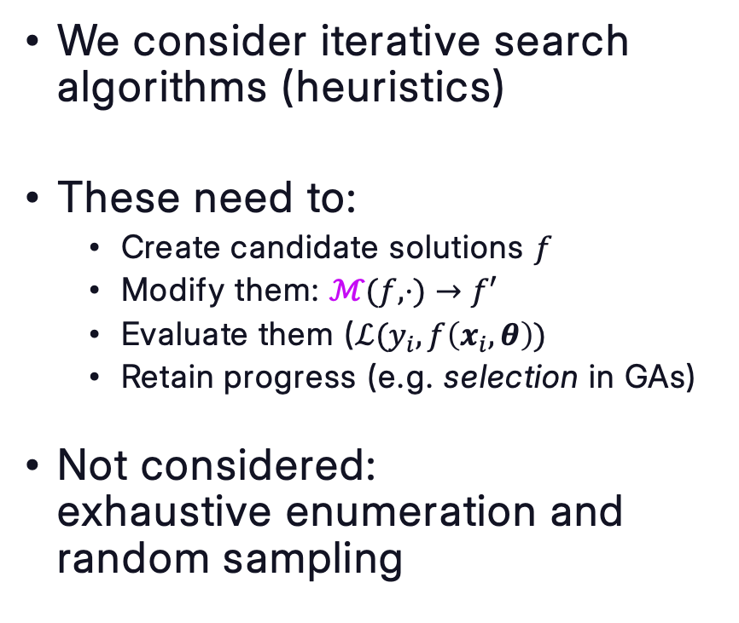
The stage – iterative, heuristic algorithms
Pic. from [2]
We consider iterative search algorithms (heuristics)
These need to:
  Create candidate solutions $f$
  Modify them: $ℳ(f, ⋅)→f′$
  Evaluate them ($ℒ(y_{i},f\left(x_{i},θ\right))$
  Retain progress (e.g. selection in GAs)
Not considered:
exhaustive enumeration and random sampling
GIF from [3] - MIT

Slide 5
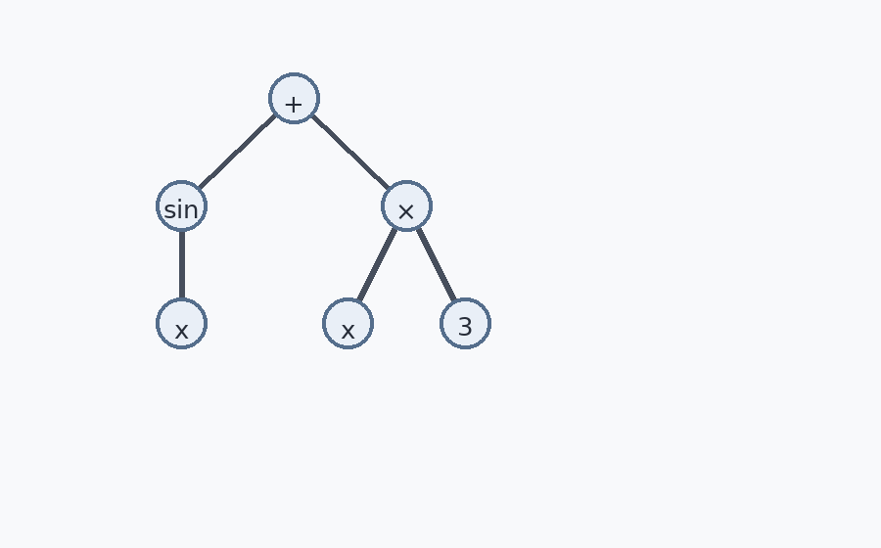
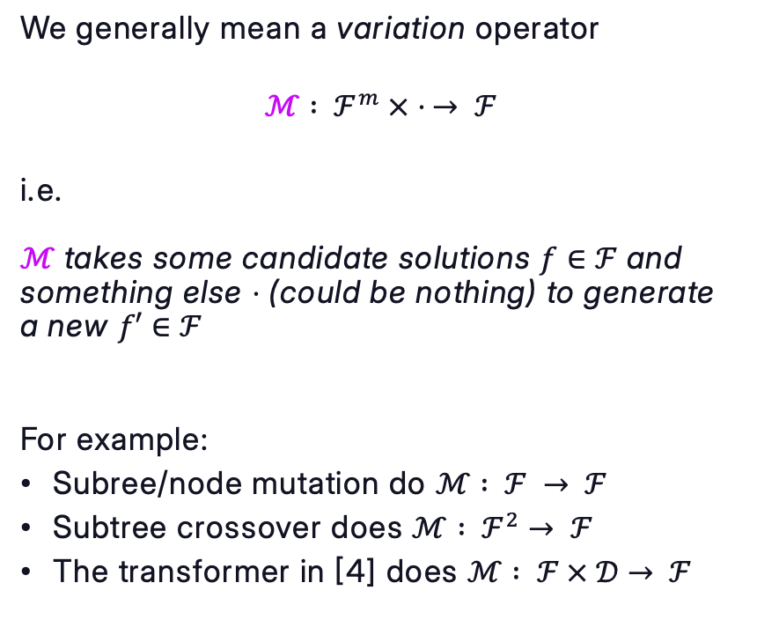
The player – “mutation”
We generally mean a variation operator
$$ℳ : ℱ^{m} × ⋅ → ℱ$$
i.e.
$ℳ$ takes some candidate solutions $f∈$ $ℱ$ and something else $⋅$ (could be nothing) to generate a new $f′∈$ $ℱ$
For example:
Subree/node mutation do $ℳ : ℱ → ℱ$
Subtree crossover does $ℳ : ℱ^{2}→ ℱ$
The transformer in [4] does $ℳ : ℱ × 𝒟→ ℱ$

Slide 6

Quick note
Here:
Tree encoding
Linear/Token encoding (tree parse)
Solution representation
Mutation

Slide 7
The match – the “evolution” of mutation over 30+ years
Semantic
LLM/Agentic
Structural
Neural
Evolution of $ℳ$
1990s
2026

Slide 8
Structural mutation
From “tree twiddling” to probabilistic- and linkage-based (1990s – 2010s)

Slide 9
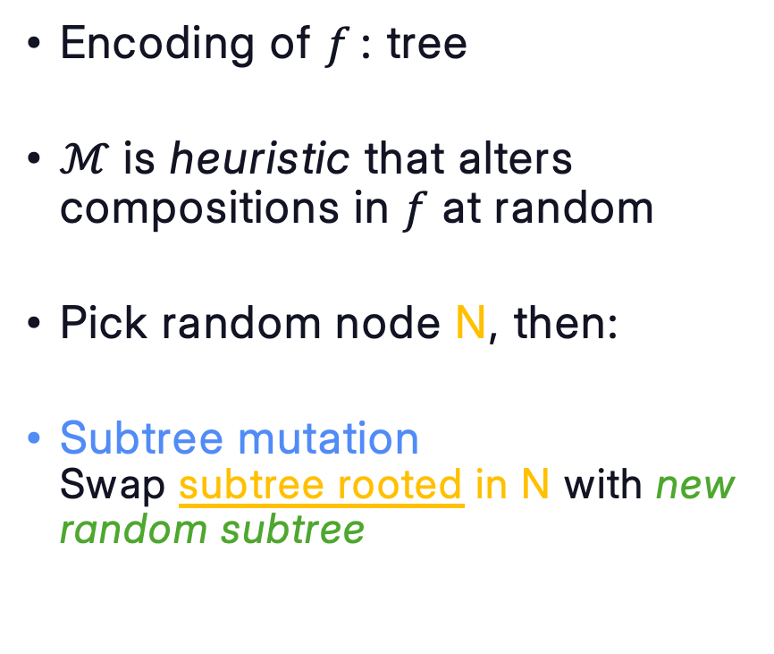
Structural: Tree “twiddling”
Encoding of $f$: tree
$ℳ$ is heuristic that alters compositions in $f$ at random
Pick random node N, then:
Subtree mutation
Swap subtree rooted in N with new random subtree

Slide 10
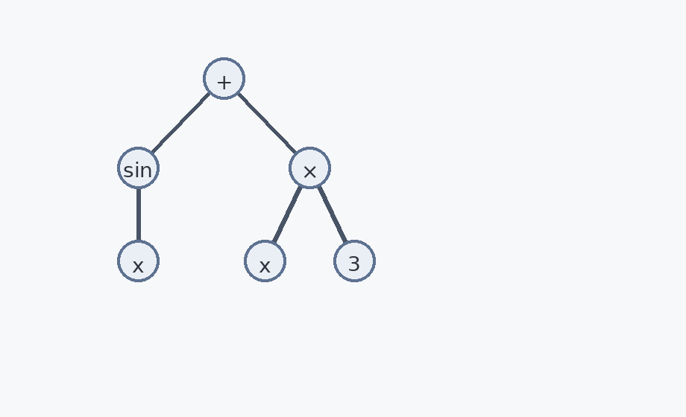
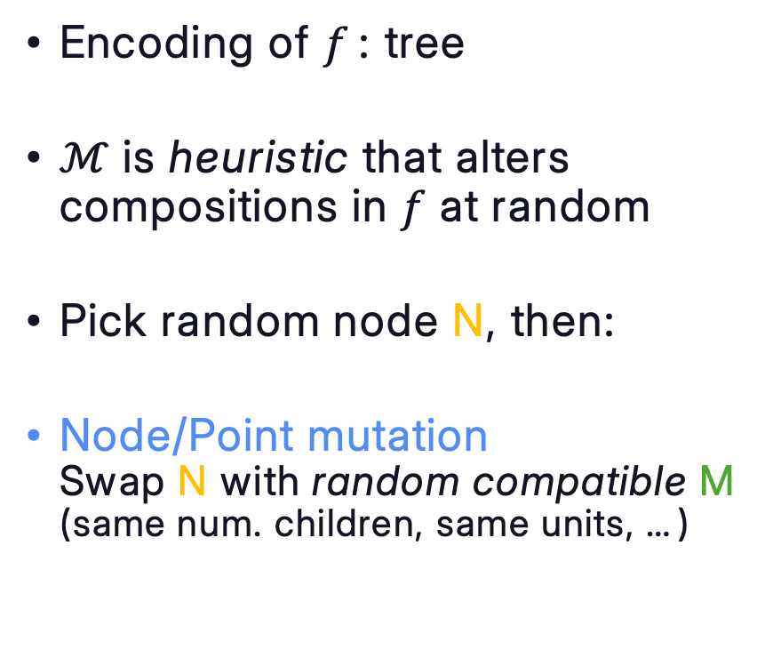
Structural: Tree “twiddling”
Encoding of $f$: tree
$ℳ$ is heuristic that alters compositions in $f$ at random
Pick random node N, then:
Node/Point mutation
Swap N with random compatible M (same num. children, same units, …)

Slide 11
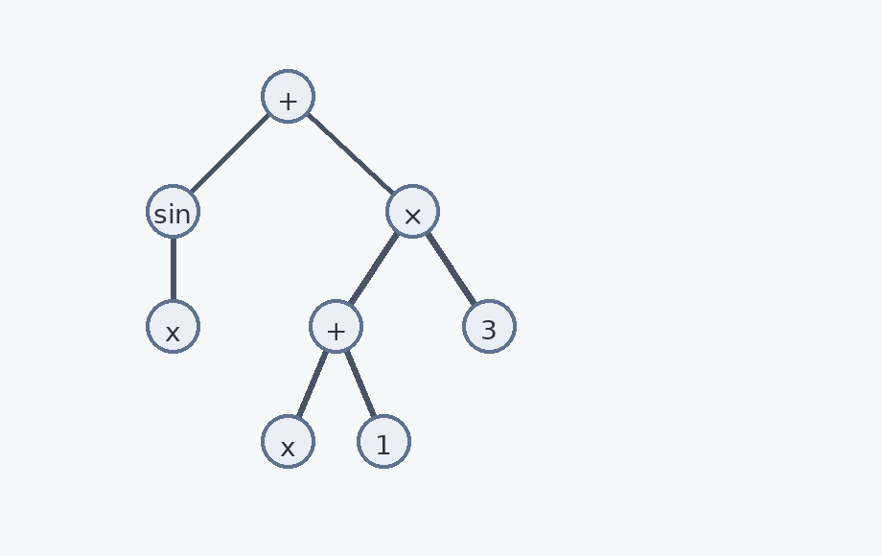
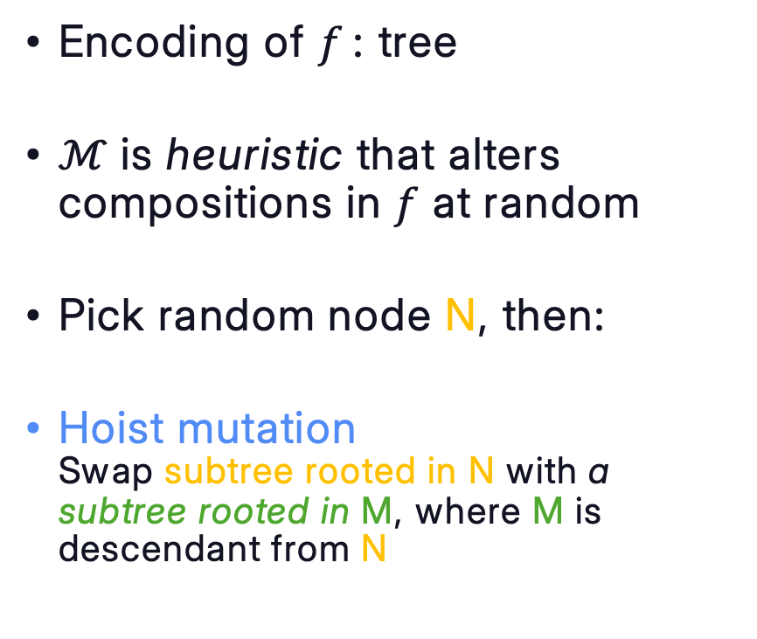
Structural: Tree “twiddling”
Encoding of $f$: tree
$ℳ$ is heuristic that alters compositions in $f$ at random
Pick random node N, then:
Hoist mutation
Swap subtree rooted in N with a subtree rooted in M, where M is descendant from N

Slide 12
Structural: Tree “twiddling”
Other mutation methods exist [5]
  Permutation mutation: swap children order
  Expansion mutation: replace terminal with subtree
  Shrink mutation: replace subtree with terminal
  …
Also: variants in how to pick N or gen. new subtree
  Uniformly at random: deeper nodes more common
  Koza rule: 90% internal – 10 % terminal
  Uniform depth: first rand. depth, then rand. node [6]
  Size-fair: bounds size of replacing subtree [7]
No clear best across problems
Modern frameworks use a mix
+
Hyperparam-tune

Slide 13
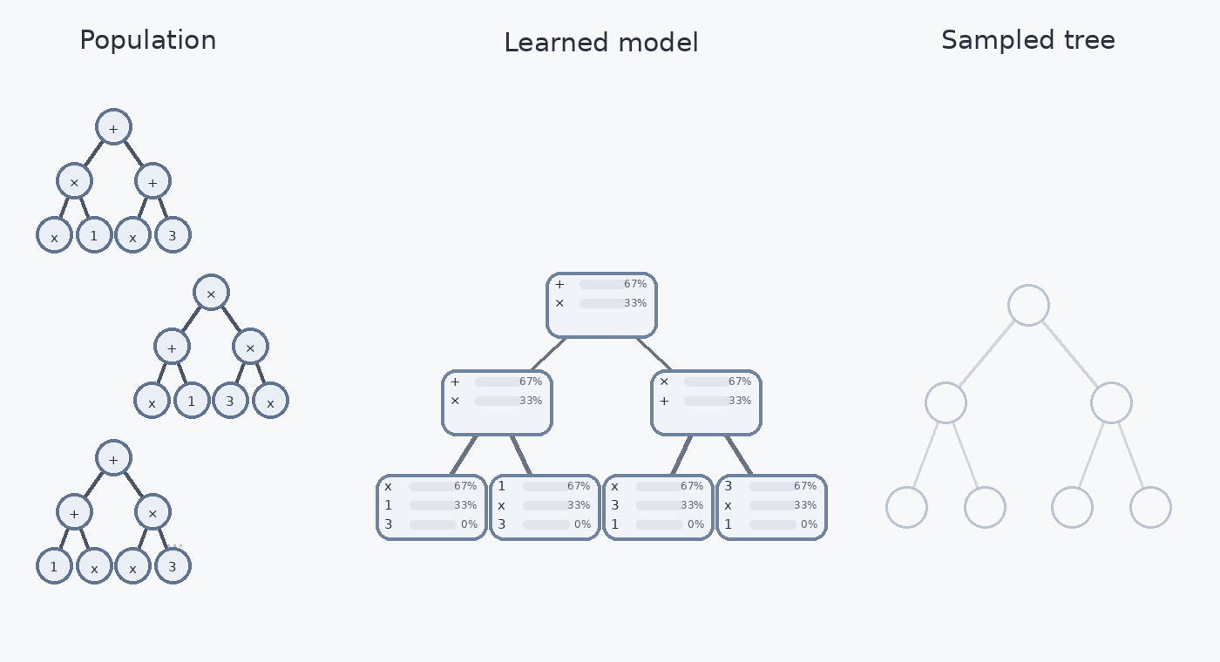
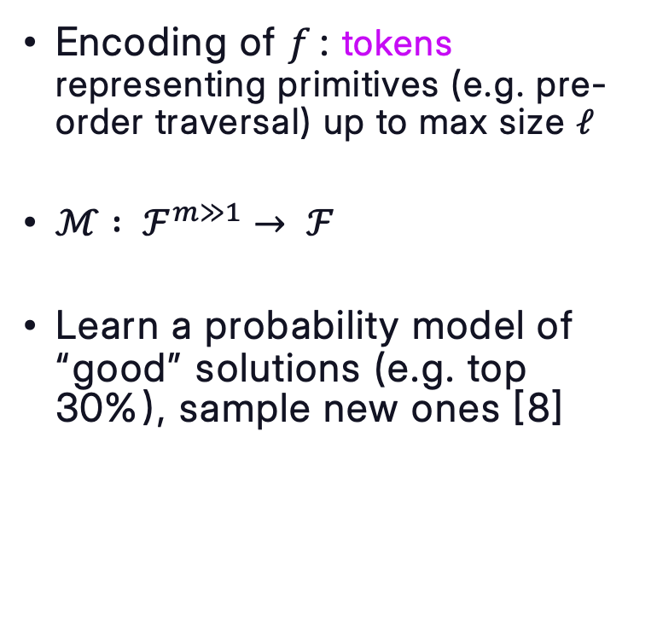
Probabilistic model-based
Encoding of $f$: tokens representing primitives (e.g. pre-order traversal) up to max size $ℓ$
$ℳ$ $: ℱ^{m≫1}→ ℱ$
Learn a probability model of “good” solutions (e.g. top 30%), sample new ones [8]

Slide 14
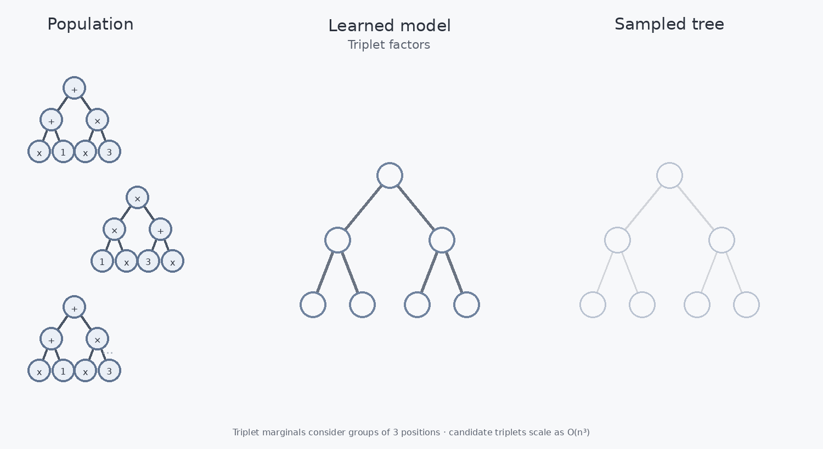
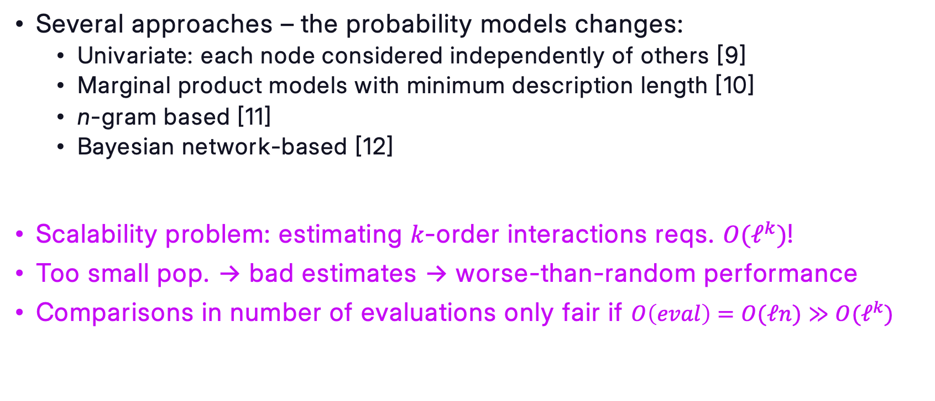
Probabilistic model-based
Several approaches – the probability models changes:
  Univariate: each node considered independently of others [9]
  Marginal product models with minimum description length [10]
  n-gram based [11]
  Bayesian network-based [12]
Scalability problem: estimating $k$-order interactions reqs. $O(ℓ^{k})$!
Too small pop. -> bad estimates -> worse-than-random performance
Comparisons in number of evaluations only fair if $O\left(eval\right)=O(ℓn)≫O(ℓ^{k})$

Slide 15
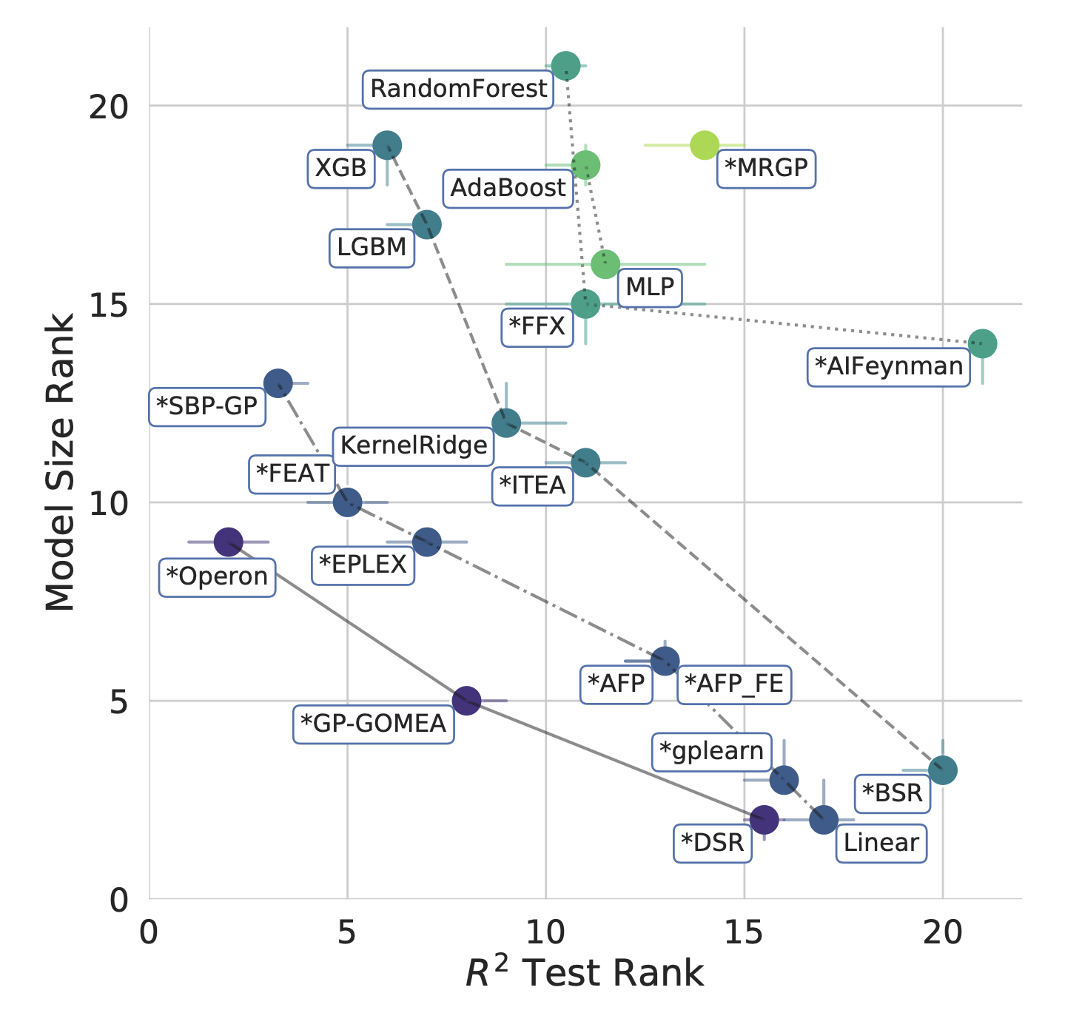
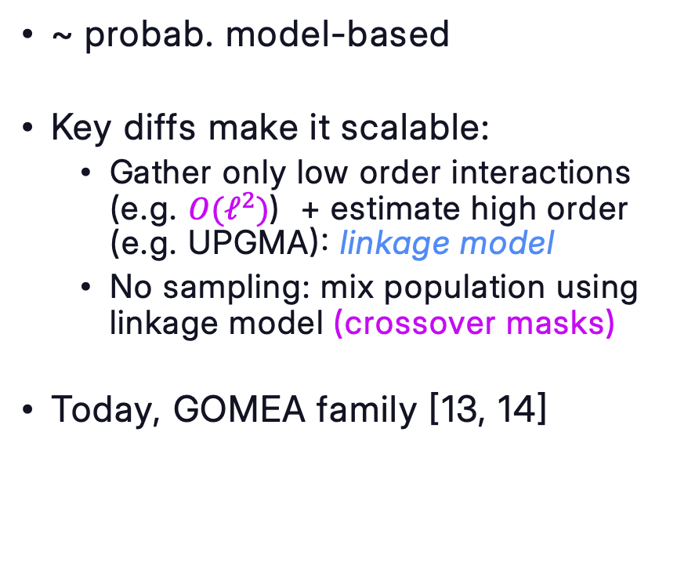
Linkage-based
~ probab. model-based
Key diffs make it scalable:
  Gather only low order interactions (e.g. $O(ℓ^{2})$) + estimate high order (e.g. UPGMA): linkage model
  No sampling: mix population using linkage model (crossover masks)
Today, GOMEA family [13, 14]
Pic from [15] – Permission by author

Slide 16
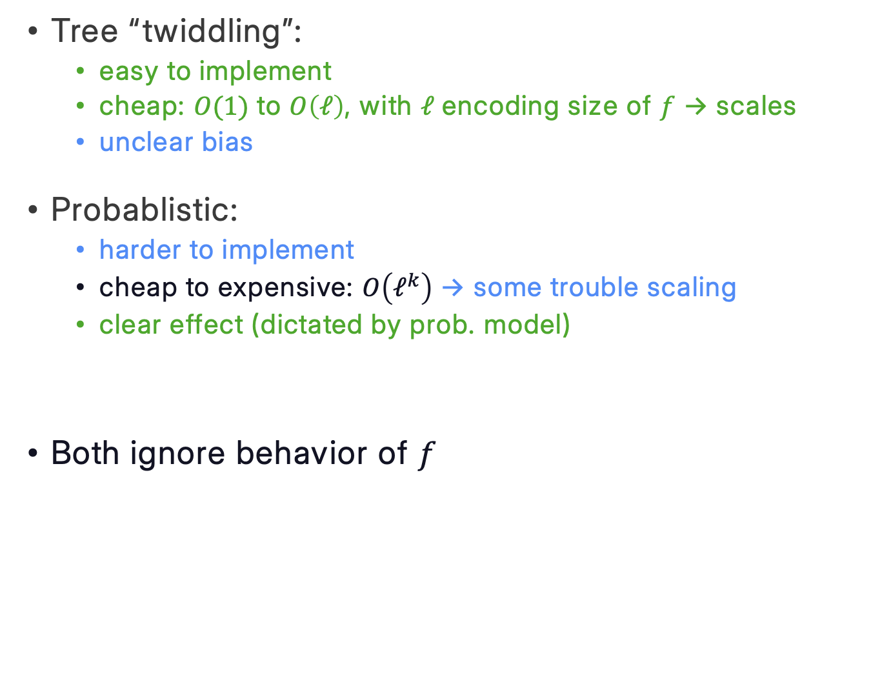
Structural: pros & cons
Tree “twiddling”:
  easy to implement
  cheap: $O(1)$ to $O\left(ℓ\right)$, with $ℓ$ encoding size of $f$ -> scales
  unclear bias
Probablistic:
  harder to implement
  cheap to expensive: $O\left(ℓ^{k}\right)$ -> some trouble scaling
  clear effect (dictated by prob. model)
Both ignore behavior of $f$

Slide 17
Semantic mutation
Geometric semantic & semantic backpropagation (2010s-2020s)

Slide 18
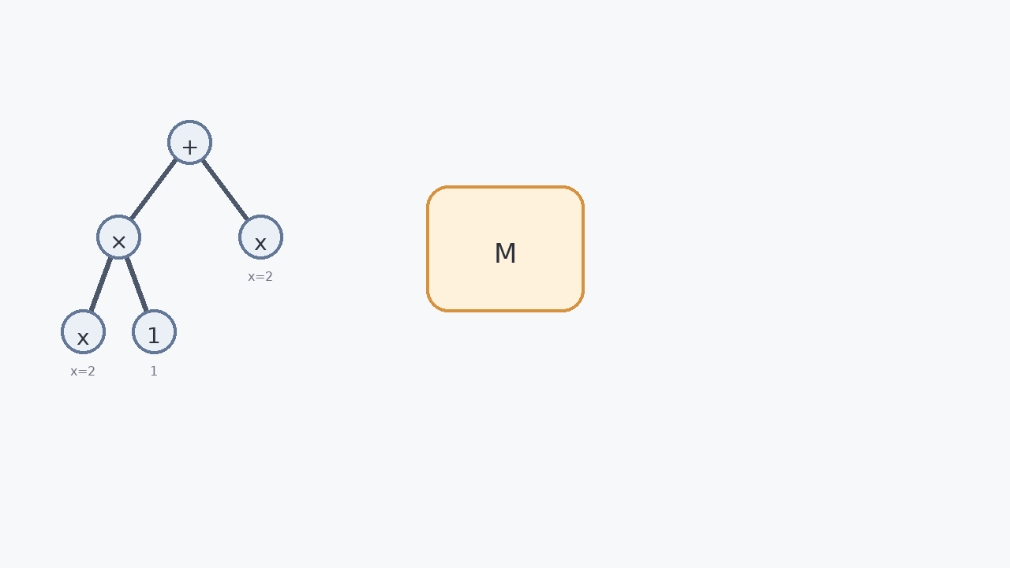
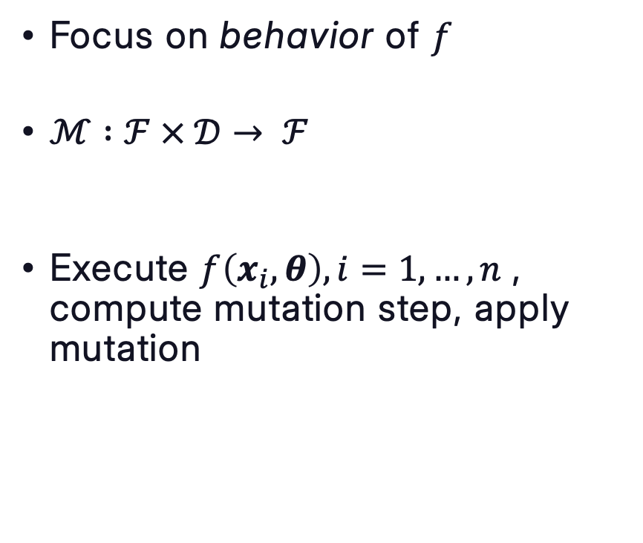
Semantic: main idea
Focus on behavior of $f$
$ℳ$ $:ℱ × 𝒟→ ℱ$
Execute $f\left(x_{i},θ\right), i=1, …, n$ , compute mutation step, apply mutation

Slide 19
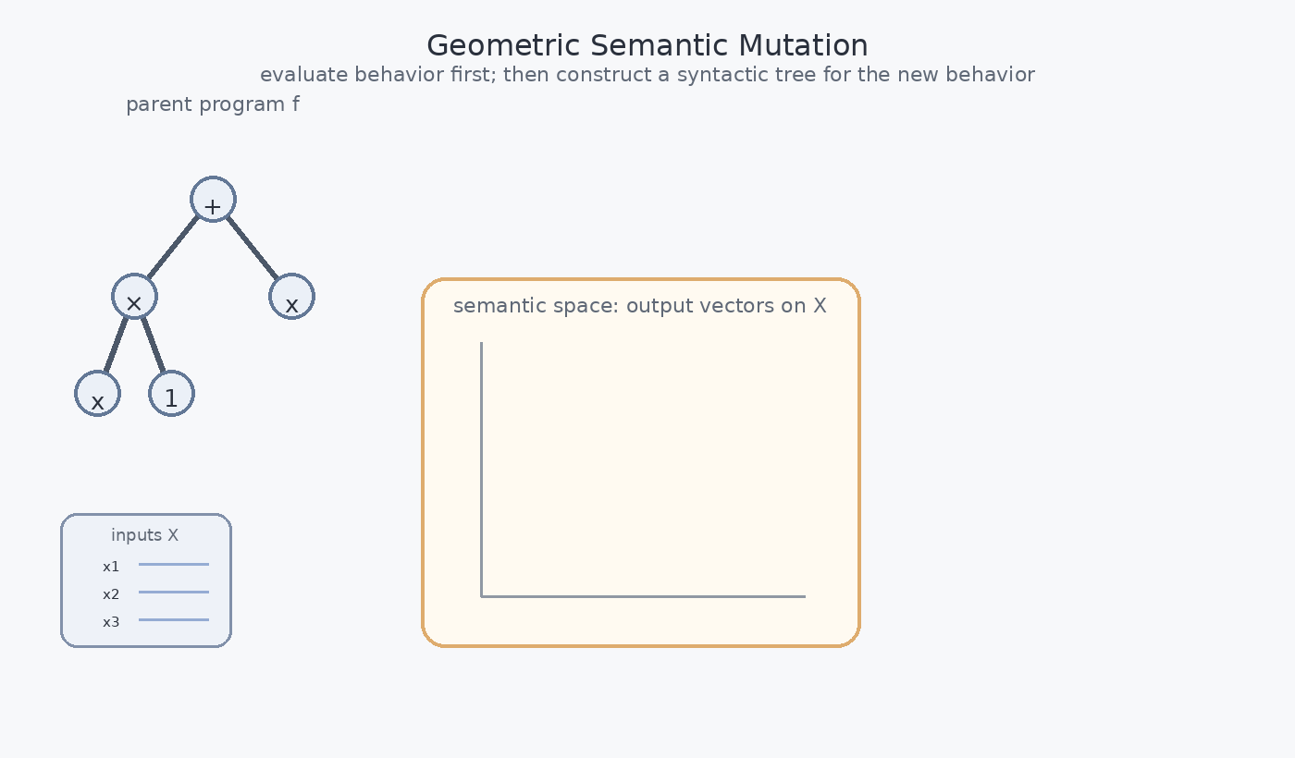
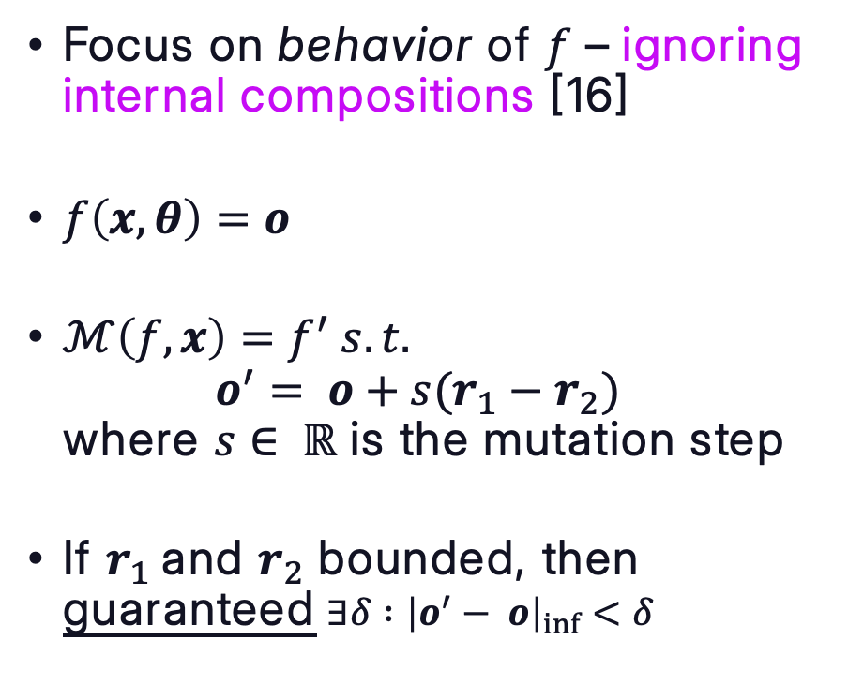
Semantic: geometric semantic mutation
Focus on behavior of $f$ – ignoring internal compositions [16]
$f\left(x,θ\right)=o$
$ℳ\left(f, x\right)=f^{′} s.t.$
$o^{′}= o+s(r_{1}−r_{2})$
where $s∈ ℝ$ is the mutation step
If $r_{1}$and $r_{2}$ bounded, then guaranteed $∃δ :{\left|o^{′}− o\right|}_{inf}<δ$

Slide 20
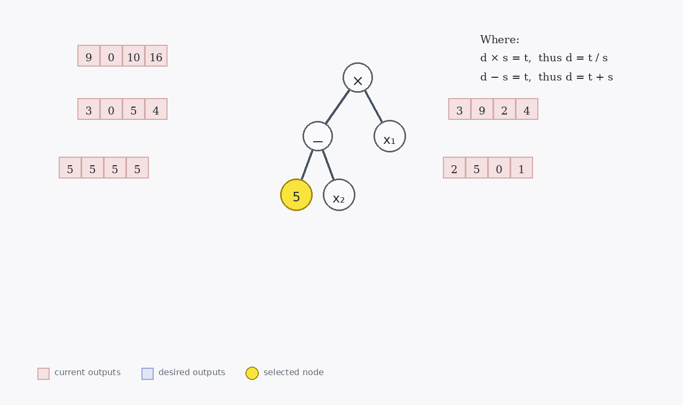
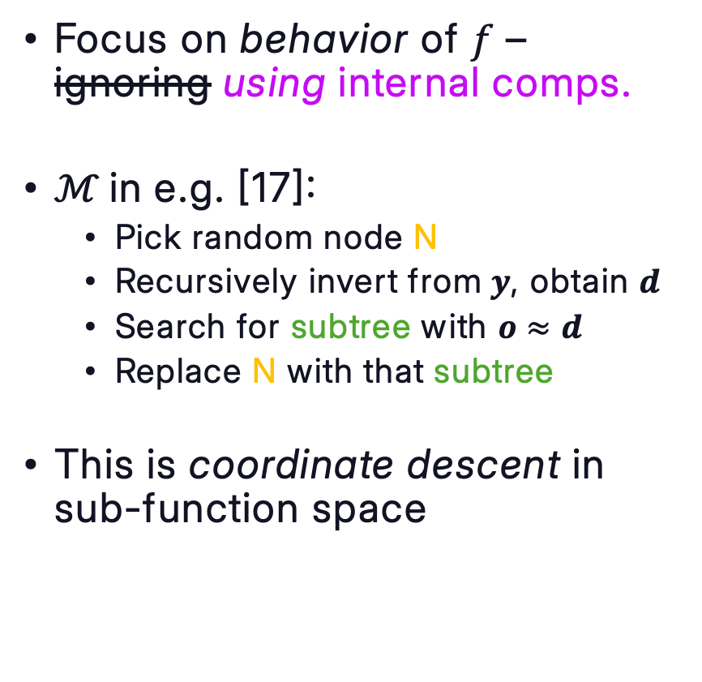
Semantic: semantic backpropagation
Focus on behavior of $f$ – ignoring using internal comps.
$ℳ$in e.g. [17]:
  Pick random node N
  Recursively invert from $y$, obtain $d$
  Search for subtree with $o≈d$
  Replace N with that subtree
This is coordinate descent in sub-function space
Current output
Desired output

Slide 21
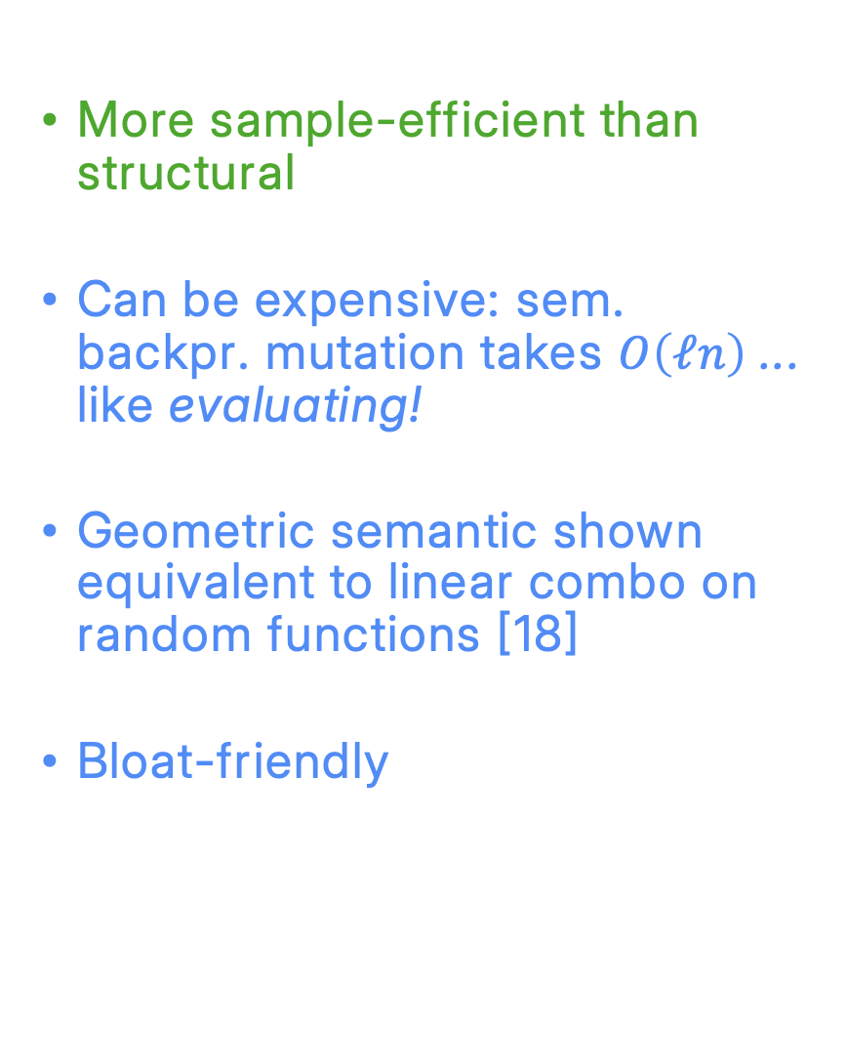
Semantic: pros & cons
More sample-efficient than structural
Can be expensive: sem. backpr. mutation takes $O\left(ℓn\right)$ ... like evaluating!
Geometric semantic shown equivalent to linear combo on random functions [18]
Bloat-friendly
Pic from [15] – Permission by author

Slide 22
Neural
Deep reinforcement learning to pre-trained transformers & hybrids (2020s)

Slide 23
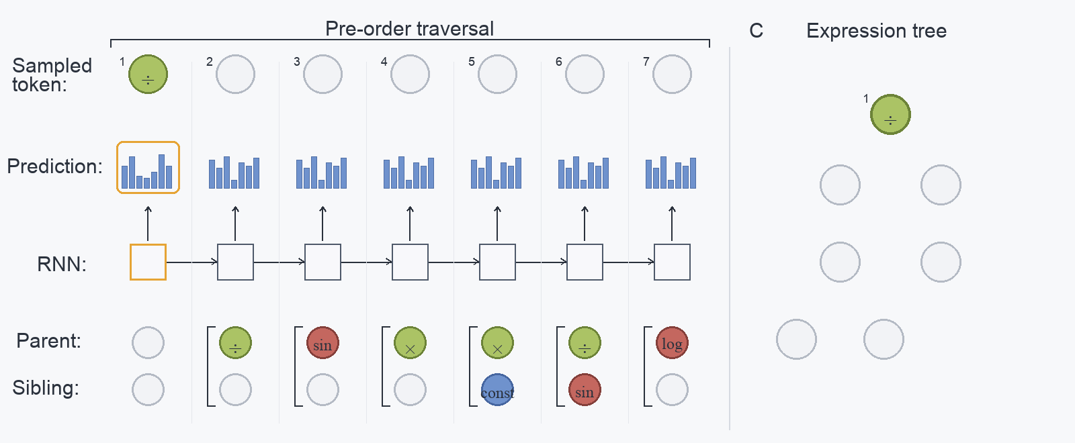
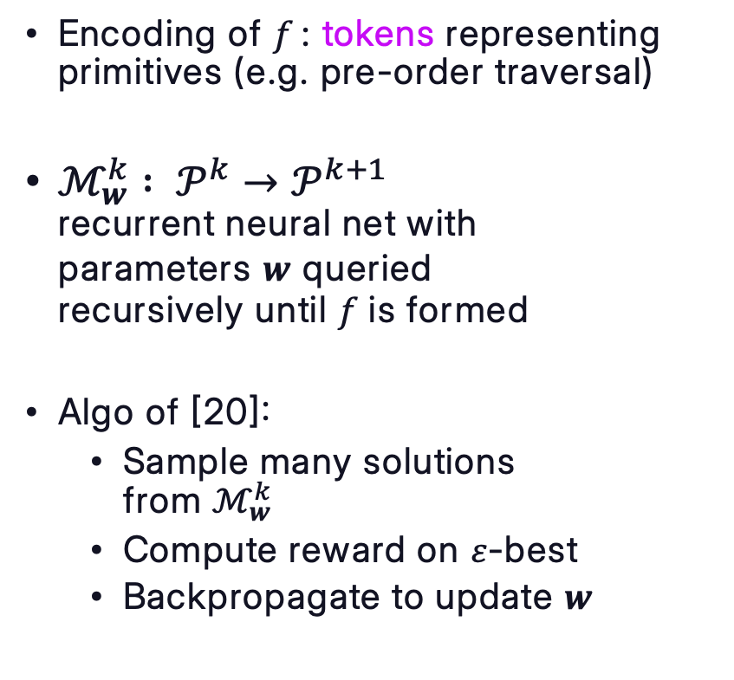
Neural: reinforcement learning
Encoding of $f$: tokens representing primitives (e.g. pre-order traversal)
$ℳ_{w}^{k}$ $: 𝒫^{k}→𝒫^{k+1}$
recurrent neural net with
parameters $w$ queried
recursively until $f$ is formed
Algo of [20]:
  Sample many solutions
  from $ℳ_{w}^{k}$
  Compute reward on $ε$-best
  Backpropagate to update $w$
For a similar idea, but more clearly similar to
probab. model-based, see [21]

Slide 24
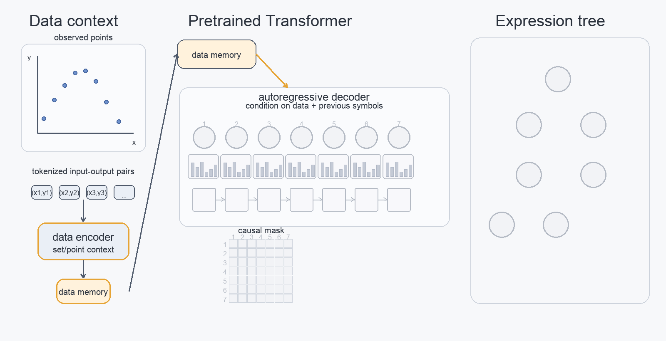
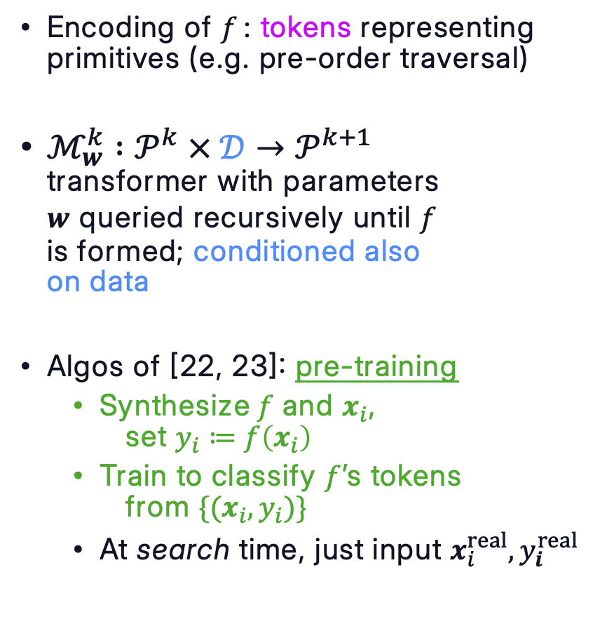
Neural: pre-trained transformers
Encoding of $f$: tokens representing primitives (e.g. pre-order traversal)
$ℳ_{w}^{k}$ $:𝒫^{k} × 𝒟→𝒫^{k+1}$
transformer with parameters
$w$ queried recursively until $f$
is formed; conditioned also
on data
Algos of [22, 23]: pre-training
  Synthesize$f$ and $x_{i}$,
  set $y_{i}≔f\left(x_{i}\right)$
  Train to classify $f$’s tokens
  from $\{(x_{i},y_{i})\}$
  At search time, just input $x_{i}^{real}, y_{i}^{real}$

Slide 25
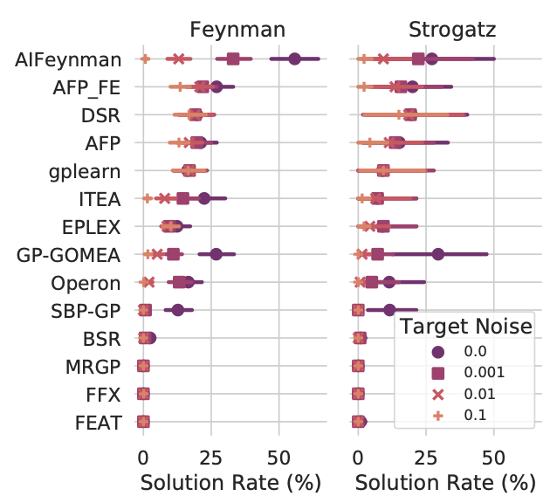
Neural: pros & cons
Essentially: modern probabilistic model-based – the neural net is the model
Captures higher order interactions approximately, remaining computationally cheap
In practice, success shown mostly on smaller problems (e.g. recovery of Feynman benchmark)
Pic from [15]
Pic from [15] – Permission by author

Slide 26
LLM/Agentic
From optimization by prompting to AlphaEvolve and automodel (2023-2026)

Slide 27
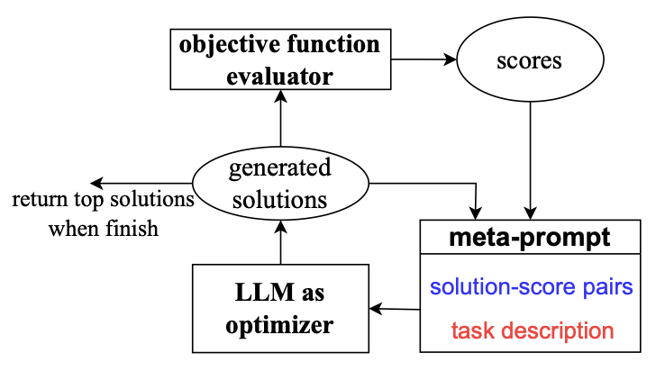
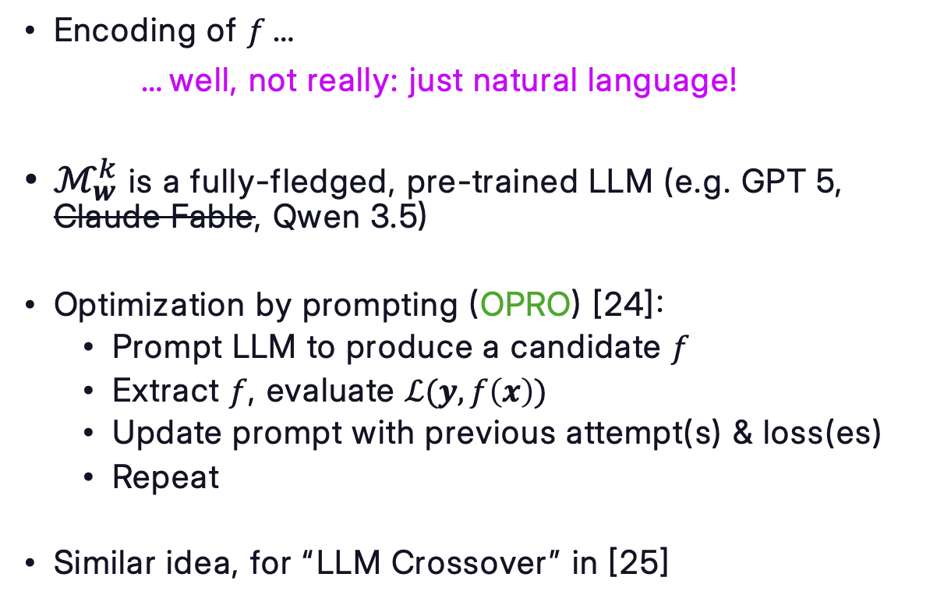
LLM-based optimization: simple orchestration
Encoding of $f$…
…well, not really: just natural language!
$ℳ_{w}^{k}$ is a fully-fledged, pre-trained LLM (e.g. GPT 5, Claude Fable, Qwen 3.5)
Optimization by prompting (OPRO) [24]:
  Prompt LLM to produce a candidate $f$
  Extract $f$, evaluate $ℒ(y, f\left(x\right))$
  Update prompt with previous attempt(s) & loss(es)
  Repeat
Similar idea, for “LLM Crossover” in [25]
Pic from [24] – CC0

Slide 28
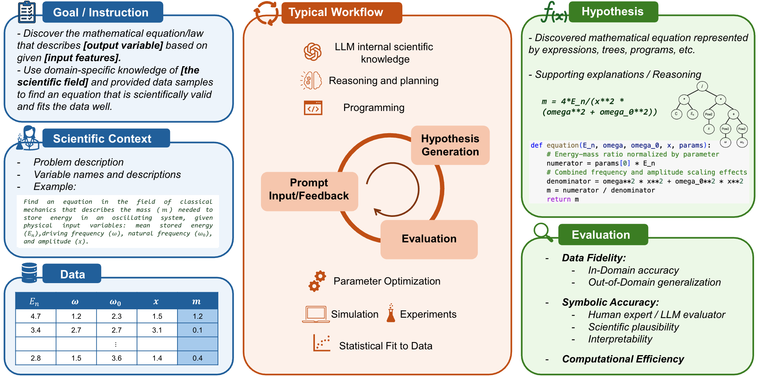
LLM/Agentic applied to symbolic regression
Pic from repo of [27] - MIT

Slide 29

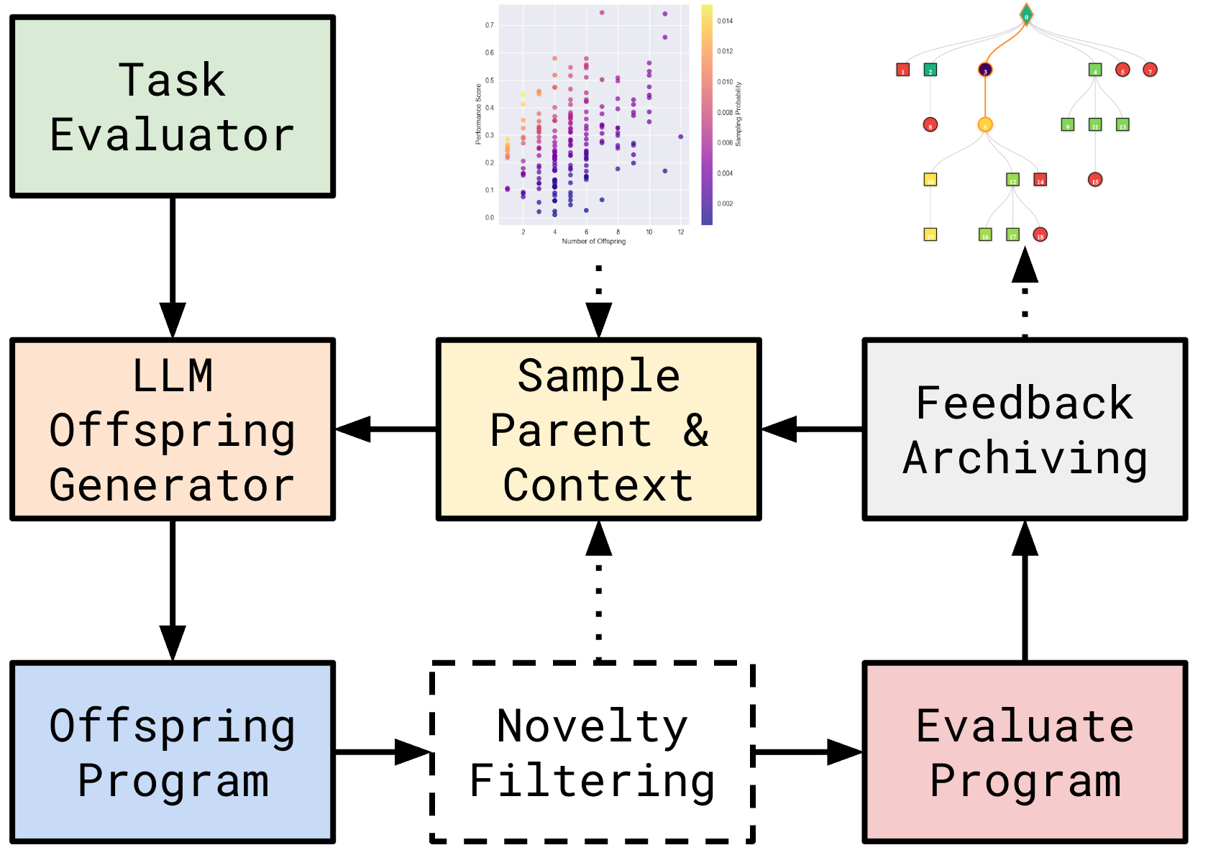
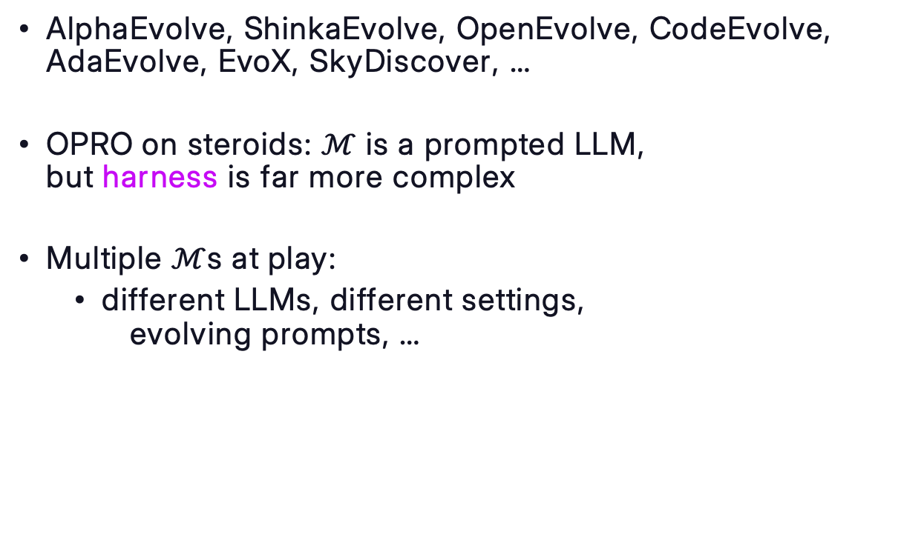
LLM-based optimization: complex orchestration
AlphaEvolve, ShinkaEvolve, OpenEvolve, CodeEvolve, AdaEvolve, EvoX, SkyDiscover, …
OPRO on steroids: $ℳ$ is a prompted LLM,
but harness is far more complex
Multiple $ℳ$s at play:
  different LLMs, different settings,
  evolving prompts, …
Pics from repo of [26] – Apache 2.0

Slide 30


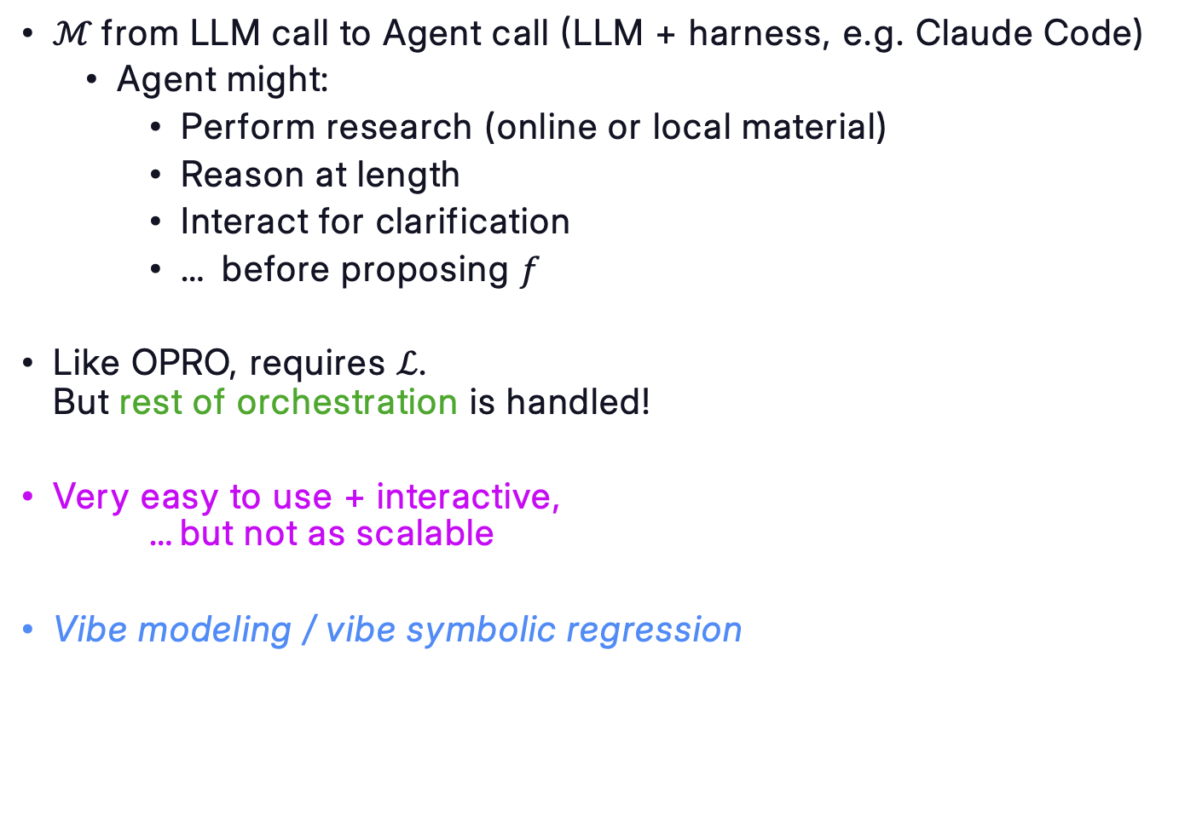
Agent-based optimization
$ℳ$from LLM call to Agent call (LLM + harness, e.g. Claude Code)
  Agent might:
    Perform research (online or local material)
    Reason at length
    Interact for clarification
    … before proposing $f$
Like OPRO, requires $ℒ$.
But rest of orchestration is handled!
Very easy to use + interactive,
…but not as scalable
Vibe modeling / vibe symbolic regression
automodel
an agent skill for model search
npx skills add unlayer-ai/automodel

Slide 31
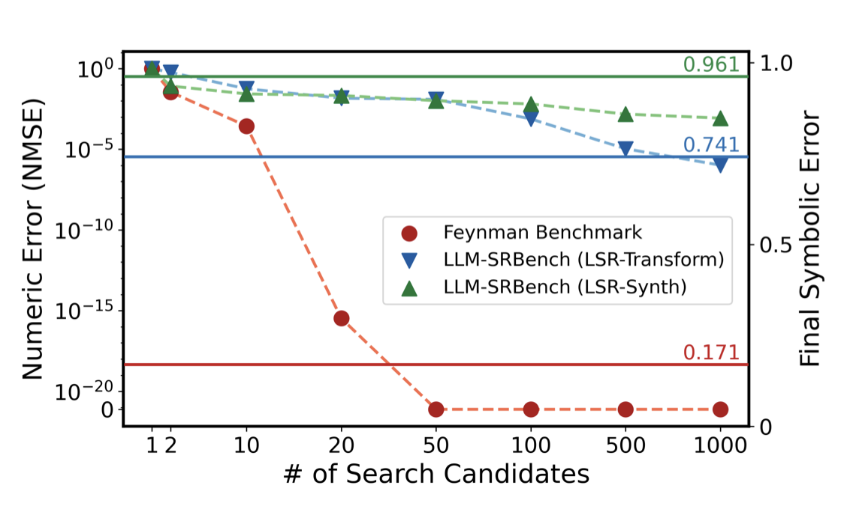
LLM/Agentic: pros & cons
A new beast entirely
Human-like: super sample-
efficient
Really easy to set up
Slooow: ~seconds
Careful with memorization!
Pic from [27] - CC BY 4.0

Slide 32
Genetic and agentic symbolic regression of distributed rate-and-state friction models
Luigi Romano¹, Alessandro Lucantonio², Marco Virgolin³
¹Linköping University (SE), ²Aarhus University (DK), ³Unlayer AI (NL)

Slide 33
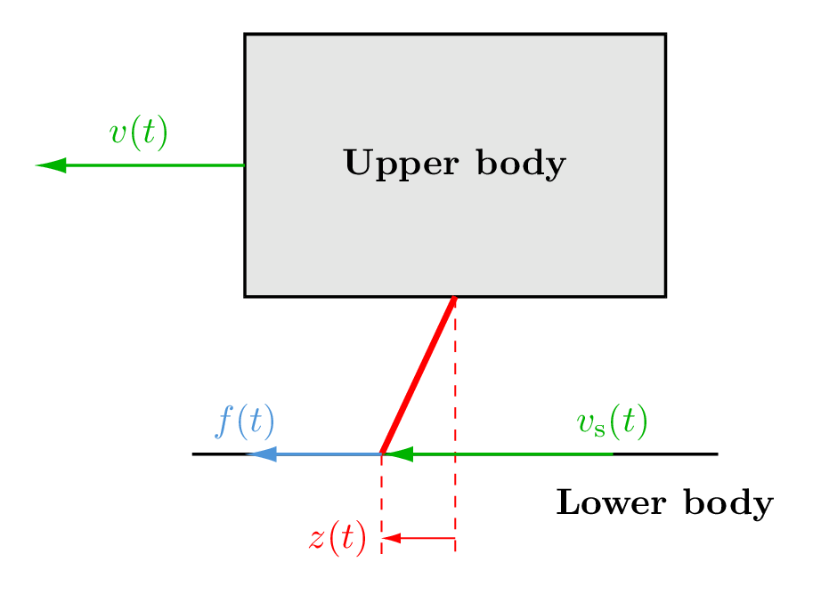
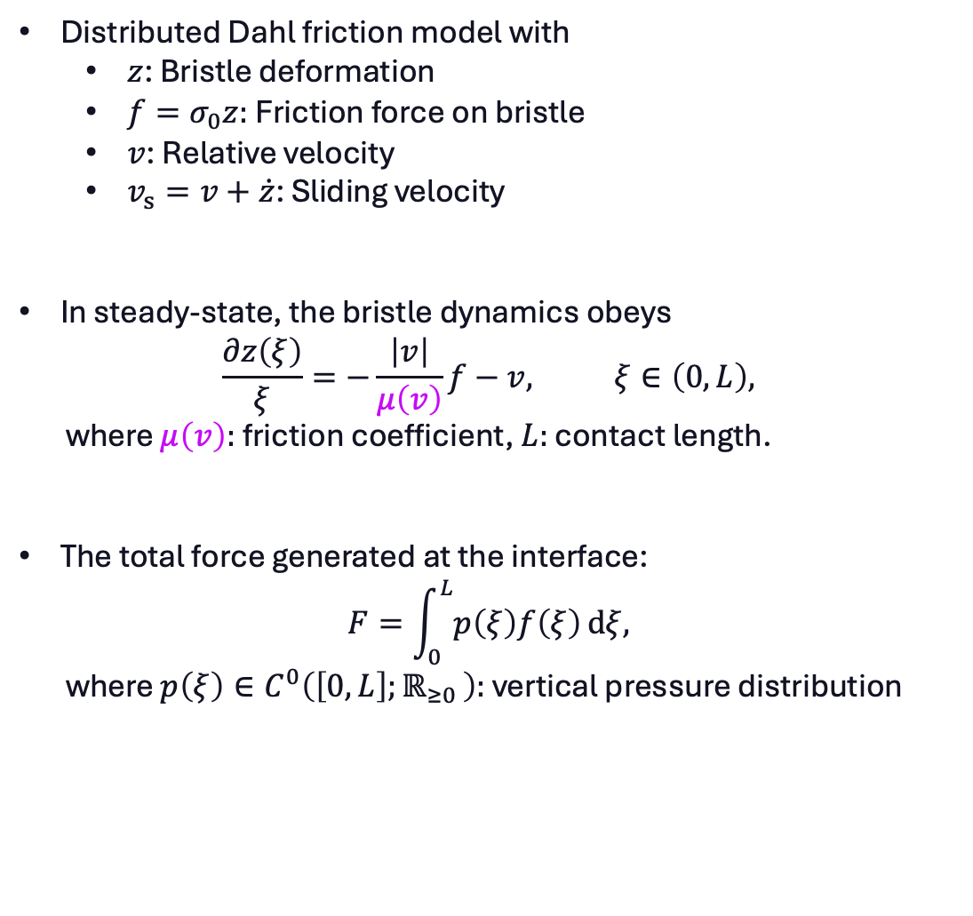
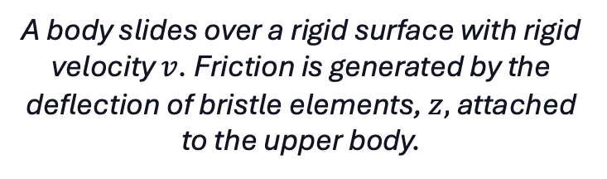
Friction model
Distributed Dahl friction model with
  $z$: Bristle deformation
  $f=σ_{0}z:$Friction force on bristle
  $v$: Relative velocity
  $v_{s}=v+\dot{z}$: Sliding velocity
In steady-state, the bristle dynamics obeys
$$\frac{∂z\left(ξ\right)}{ξ}=−\frac{\left|v\right|}{μ\left(v\right)}f−v, ξ∈\left(0,L\right),$$
where $μ\left(v\right):$friction coefficient, $L:$ contact length.
The total force generated at the interface:
$$F=\int_{0}^{L}{p\left(ξ\right)f\left(ξ\right)}dξ,$$
where $p\left(ξ\right)∈C^{0}\left(\left[0,L\right];ℝ_{≥0 }\right):$ vertical pressure distribution
A body slides over a rigid surface with rigid velocity $v$. Friction is generated by the deflection of bristle elements, $z,$ attached to the upper body.

Slide 34
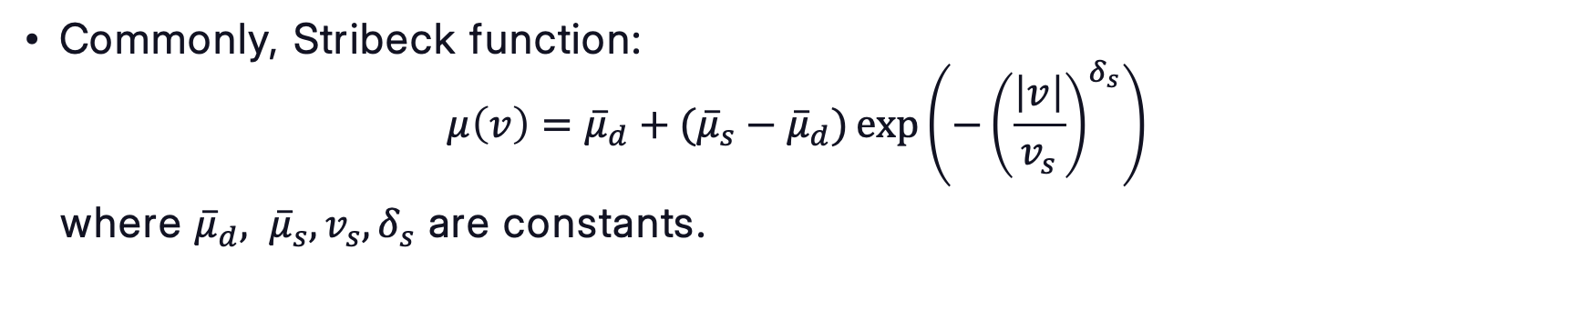
Goal: improve $μ$
Commonly, Stribeck function:
$μ\left(v\right)={\overline{μ}}_{d}+{({\overline{μ}}_{s}−\overline{μ}}_{d})\exp\left(−{\left(\frac{\left|v\right|}{v_{s}}\right)}^{δ_{s}}\right)$
where ${\overline{μ}}_{d}, {\overline{μ}}_{s}, v_{s}, δ_{s}$ are constants.
We compared classic genetic programming, random search, and an LLM agent in discovering a better function given the data.

Slide 35
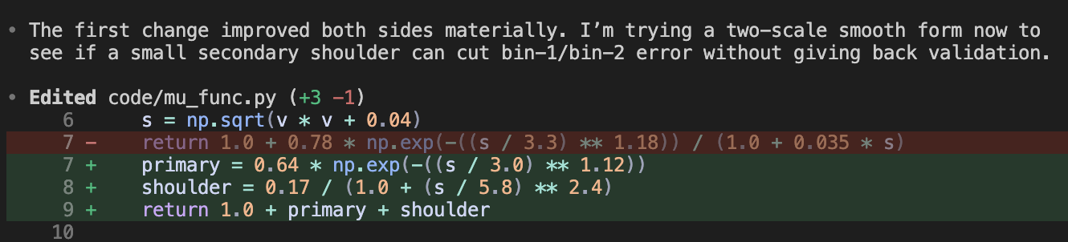
Demo

Slide 36
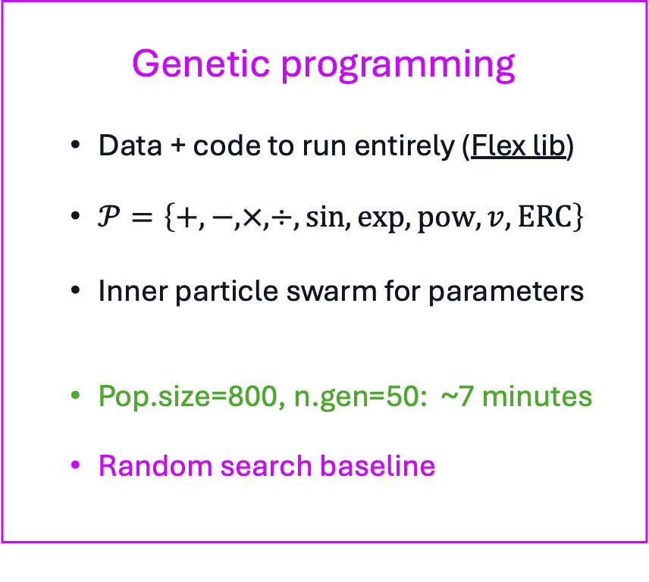
Experimental setup
LLM agent (Github Co-pilot)
  Data + code to evaluate + instructions
  No primitives needed
  No inner parameter tuning
  Iter for 20 attempts: ~ 7 minutes
Genetic programming
  Data + code to run entirely (Flex lib)
  $𝒫=\left\{+,−, ×,÷,sin, exp,pow, v, ERC\right\}$
  Inner particle swarm for parameters
  Pop.size=800, n.gen=50: ~7 minutes
  Random search baseline

Slide 37
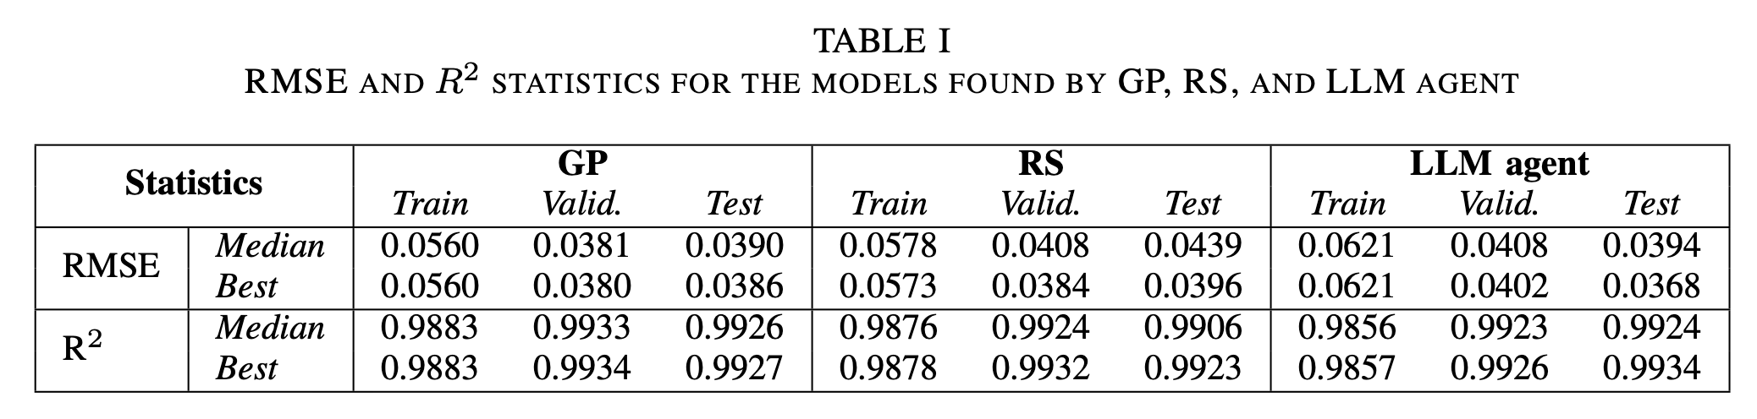
Results
GP & RS outperform LLM agent in ~7 minutes
BUT: LLM agent does 20 attempts, GP & RS do 40,000
Here, loss evaluation is cheap!

Slide 38
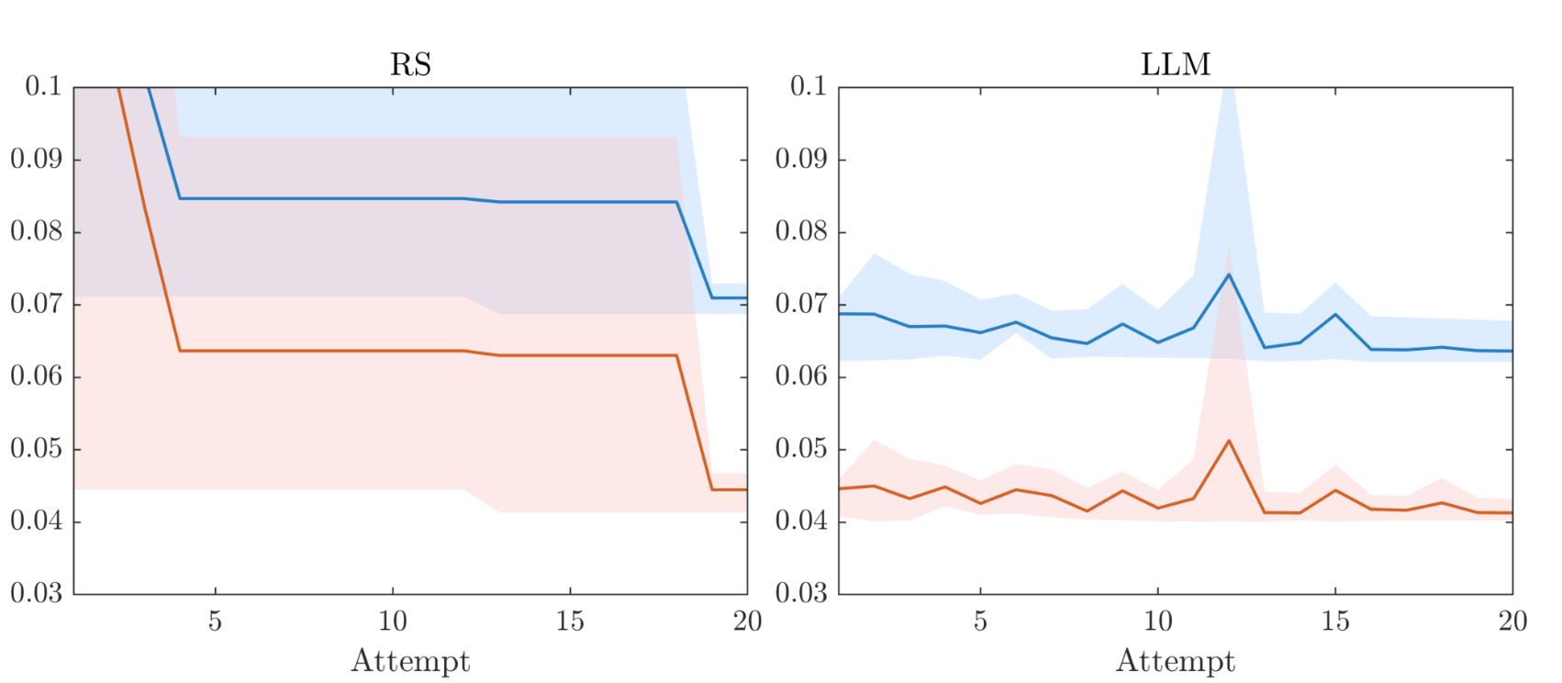
Results
Within 20 attempts
LLM agent > RS

Slide 39
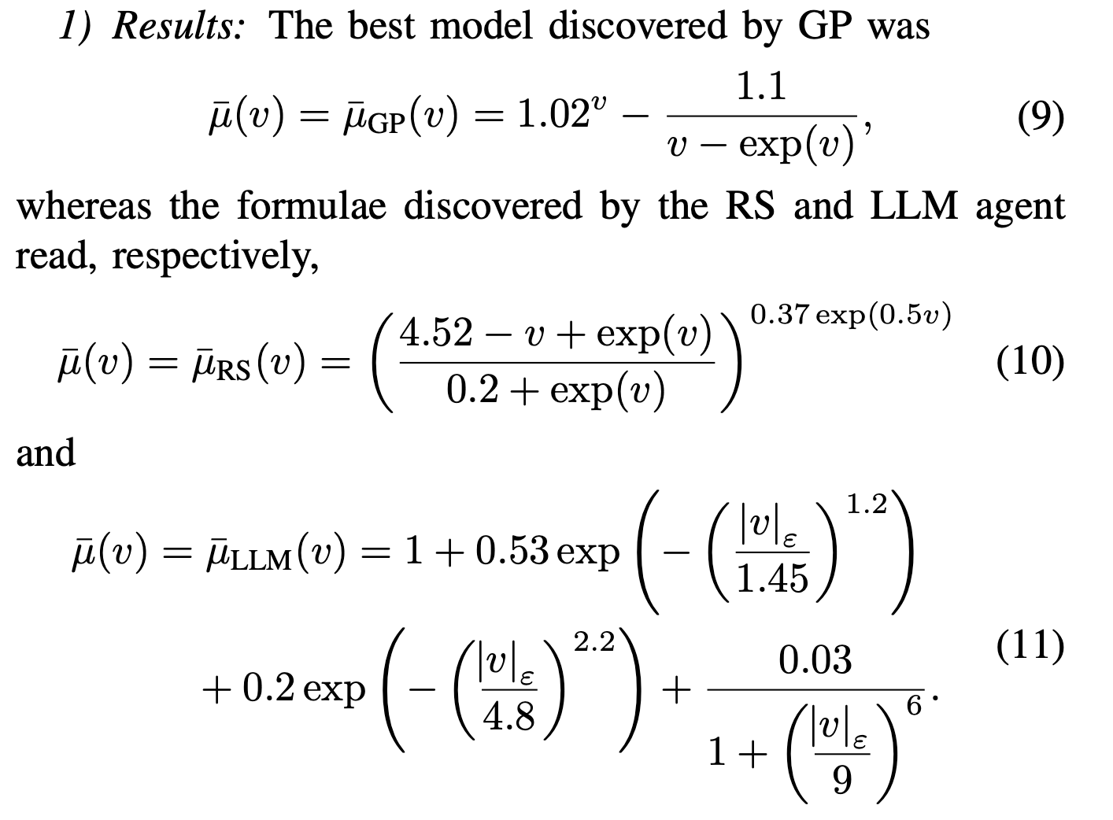
Results
All models are good
LLM more human-like

Slide 40
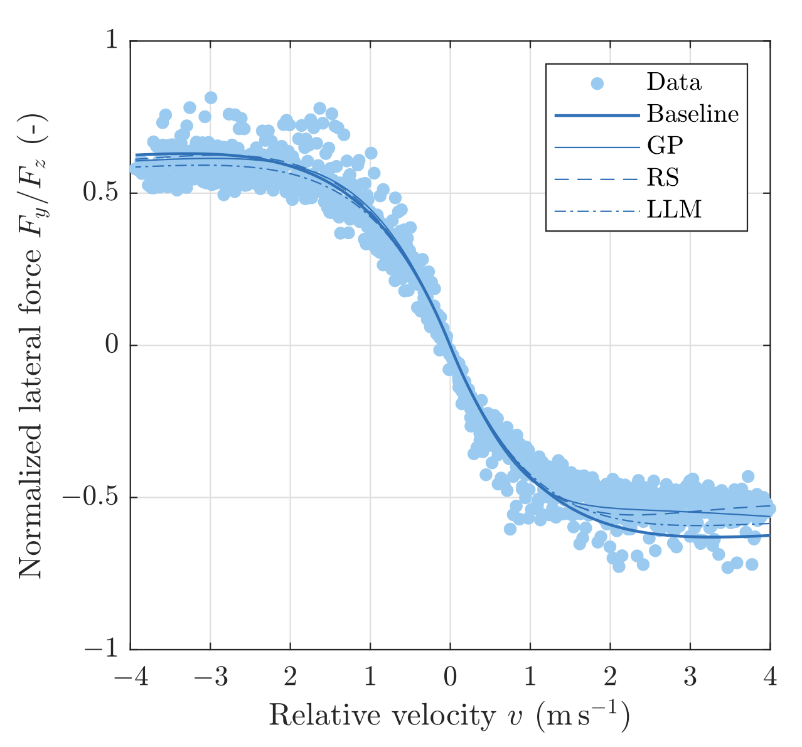
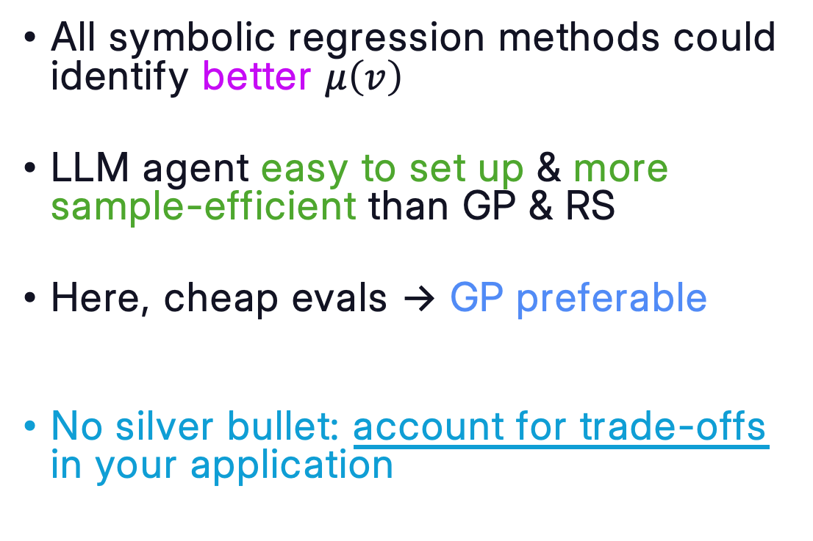
Conclusion
All symbolic regression methods could identify better $μ\left(v\right)$
LLM agent easy to set up & more sample-efficient than GP & RS
Here, cheap evals -> GP preferable
No silver bullet: account for trade-offs
in your application

Slide 41
Thank you
Marco Virgolin
Evolution of Mutation
&
Genetic and agentic symbolic regression of distributed rate-and-state friction models
– with Romano, Lucantonio
SymReg WS 2026

Slide 42
References
[1] Virgolin. “A bird’s eye view on responsible AI”. Invited talk @ TU Chalmers, Gothenburg (SE), 2022
[2] Virgolin. “Design and application of gene-pool optimal mixing evolutionary algorithms for genetic programming”. PhD dissertation, 2020
[3] Virgolin. “genepro”. Github repository, 2024
[4] Kamienny et al. “Deep generative symbolic regression with Monte-Carlo Tree Search”. ICLR, 2023
[5] Poli et al. “A field guide to genetic programming”. Lulu.com, 2008
[6] Kessler and Haynes. ”Depth-fair crossover in genetic programming”. SAC, 1999
[7] Langdon. “The evolution of size in genetic programming”. Genetic programming, 1998
[8] Kim et al. “Probabilistic model building in genetic programming: a critical review”. GPEM, 2014
[9] Salustowicz and Schmidhuber. “Probabilistic incremental program evolution”. Evolutionary computation, 1997
[10] Sastry and Goldberg. “Probabilistic model building and competent genetic programming”. GPTP, 2003
[11] Hemberg et al. “An investigation of local patterns for estimation of distribution genetic programming”. GECCO, 2012
[12] Hasegawa and Iba. “A Bayesian network approach to program generation”. IEEE TEvC, 2008
[13] Dushatskiy et al. “Parameterless gene-pool optimal mixing evolutionary algorithms”. Evolutionary computation, 2024
[14] Virgolin et al. “Improving model-based genetic programming for symbolic regression of small expressions”. Evolutionary computation, 2021
[15] La Cava et al. “Contemporary symbolic regression methods and their relative performance. NeurIPS D&B track, 2021
[16] Moraglio et al. “Geomtric semantic genetic programming”. PPSN, 2012
[17] Pawlak et al. “Semantic backpropagation for designing search operators in genetic programming”. IEEE TEvC, 2014
[18] Pawlak. “Geometric semantic genetic programming is overkill”. EuroGP, 2016
[19] Virgoiin et al. ”Linear scaling with and within semantic backpropagation-based genetic programming”. GECCO, 2019
[20] Petersen et al. “Deep symbolic regression: recovering mathematical expressions from data via risk-seeking policy gradients”. ICLR, 2021
[21] Wittenberg et al. “DAE-GP: denoising autoencoder LSTM networks as probabilistic models in estimation of distribution genetic programming”. GECCO, 2020
[22] Biggio et al. “Neural symbolic regression that scales”. ICML, 2021
[23] Kamienny et al. “End-to-end symbolic regression with transformers”. NeurIPS, 2022
[24] Yang et al. “Large language models as optimizers” ICLR, 2024
[25] Meyerson et al. “Language model crossover: variation through few-shot prompting”. ACM TELO, 2024
[26] Lange et al. “ShinkaEvolve: towards open-ended and sample-efficient program evolution”. ArXiv, 2025. Repo: github.com/SakanaAI/ShinkaEvolve
[27] Shojaee et al. “LLM-SRBench: a new benchmark for scientific equation discovery with large language models”. ICML, 2025. Repo: github.com/deep-symbolic-mathematics/llm-srbench

